Slide 1
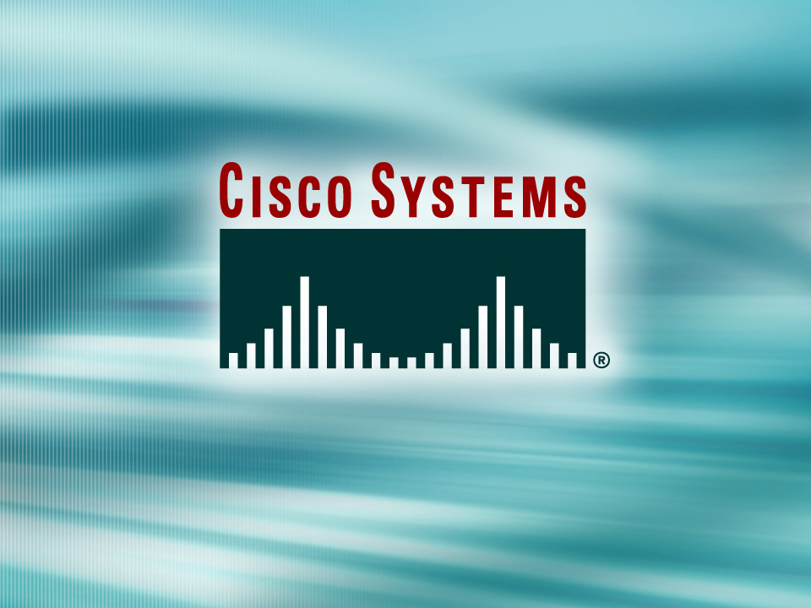
© 2002, Cisco Systems, Inc. All rights reserved.

Slide 2
Course Introduction

Slide 3
Course Objectives
Upon completing this course, you will be able to:
  Execute an add, move, or change so that the network functions in accordance with the new requirement, given a new network requirement
  Use available configuration tools to establish connectivity to the appropriate network device to complete the initial device configuration
  Build a functional configuration to support the specified network operational requirements, given a network design
  Use the command-line interface to accurately determine network device operational status and network performance

Slide 4
Course Objectives (Cont.)
Upon completing this course, you will be able to:
  Manage operating system image files to maintain an accessible operating system file and according to best practices, given a network topology
  Use IOS commands to manage device configuration files to reduce device downtime according to best practices
  Use the appropriate show commands to display network operational parameters so that anomalies are detected
  Use the appropriate debug commands to monitor network operational parameters so that events and anomalies are detected

Slide 5
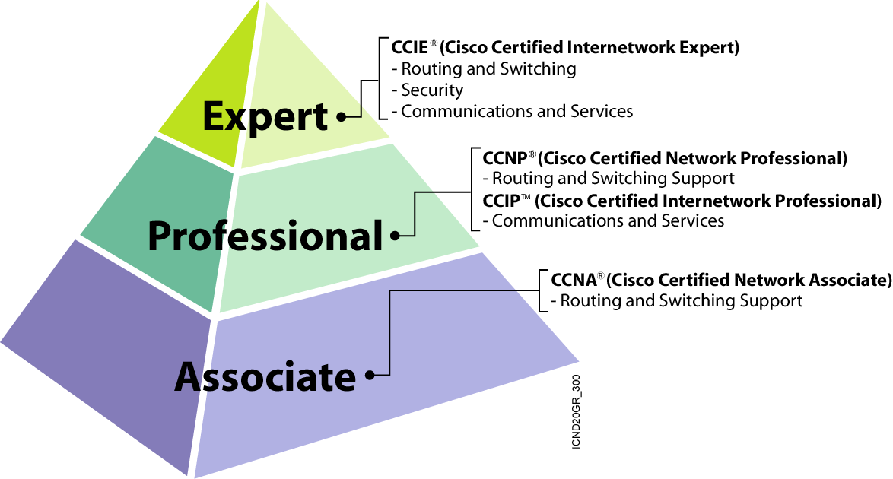
Communications and Services Certifications

Slide 6
Prerequisite Learner Skills and Knowledge
Network Components
Network
Cabling
LAN Topologies and Technologies
WAN Topologies and Technologies
Cisco Certified Network
Associate Basics (CCNAB)
Remote Access Technologies
OSI Reference
Model
TCP/IP Protocols and Applications
IP Addressing

Slide 7

Learner Responsibilities
  Complete prerequisites
  Introduce yourself
  Ask questions

Slide 8
General Administration
Class-Related
  Sign-in sheet
  Length and times
  Break and lunch room locations
  Attire
Facilities-Related
  Course materials
  Site emergency procedures
  Rest rooms
  Telephones/faxes

Slide 9
Course Roadmap
Day 1
Day 2
Day 3
Day 4
Day 5
Course
Introduction
Module 2: Managing Your Network Environment (cont.)
Module 4: Extending Switched Networks with VLANs (cont.)
Module 5: Determining IP Routes (cont.)
Module 8: Establishing Frame Relay Connections
A
M
Module 1: Operating and Configuring Cisco IOS Devices
Module 3:
Configuring
Catalyst Switch
Operations
Module 5: Determining IP Routes
Module 6: Managing IP Traffic with Access Lists
Module 9: Completing ISDN Calls
Lunch
Module 1: Operating and Configuring Cisco IOS Devices
(cont.)
Module 3:
Configuring
Catalyst Switch
Operations (cont.)
Module 6: Managing IP Traffic with Access Lists
(cont.)
P
M
Module 5: Determining IP Routes (cont.)
Module 2: Managing Your Network Environment
Module 4: Extending Switched Networks with VLANs
Module 7: Establishing Serial
Point-to-Point Connections

Slide 10
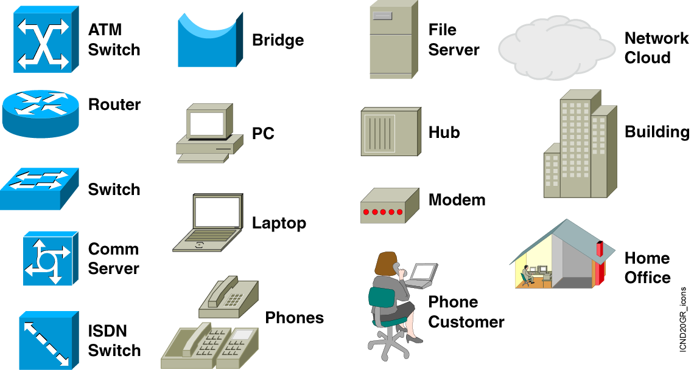
Cisco Icons and Symbols

Slide 11
Learner Introductions
  Your name
  Your company
  Skills and knowledge
  Brief history
  Objective

Slide 12


